Slide 1
Communication

Slide 2
What is communication?
Derived from the Latin word ‘commūnicāre’ – to share, to impart and the French word ‘communis’
Sharing of information, knowledge, ideas
Formal – informal
It has become an integral part of human life and is used to describe the process of transmitting and receiving messages, whether through verbal or nonverbal means

Slide 3
Definition
Communication is transfer of information from one person to another, whether or not it elicits confidence. But the information transferred must be understandable to the receiver – G.G. Brown

Slide 4
Initial models of process of communication
The Aristotelian Model – ‘Rhetoric’ – simplistic model
The Lasswell Model – emphasized the speaker – the message and the channel
The Shannon-weaver Model – integrated all components – importance of encoding the message – potential of noise in distorting a message
The Schramm Model – proposed in 1955 by Wilbur Schramm
3 models beginning from one way- shared field of experience – response from the receiver
The Katz-Lazarfeld Model- suited for mass communication
The Westley – Maclean Model – interpersonal communication
The Watlawick-beavin-Jackobson Theory – metacommunication – first to propose that communication is a two way process

Slide 5
Models of Process of Communication
Linear
Interactional
Transactional

Slide 6
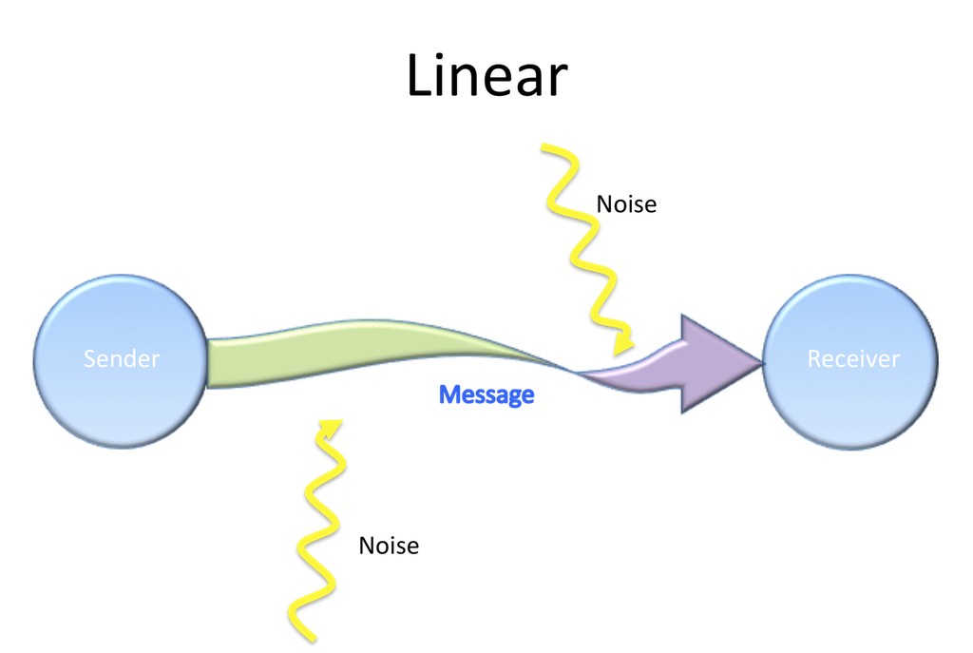
Linear Model
Developed by Shannon & Weaver in 1948
One-way, non-interactive
Speech, television broadcast

Slide 7
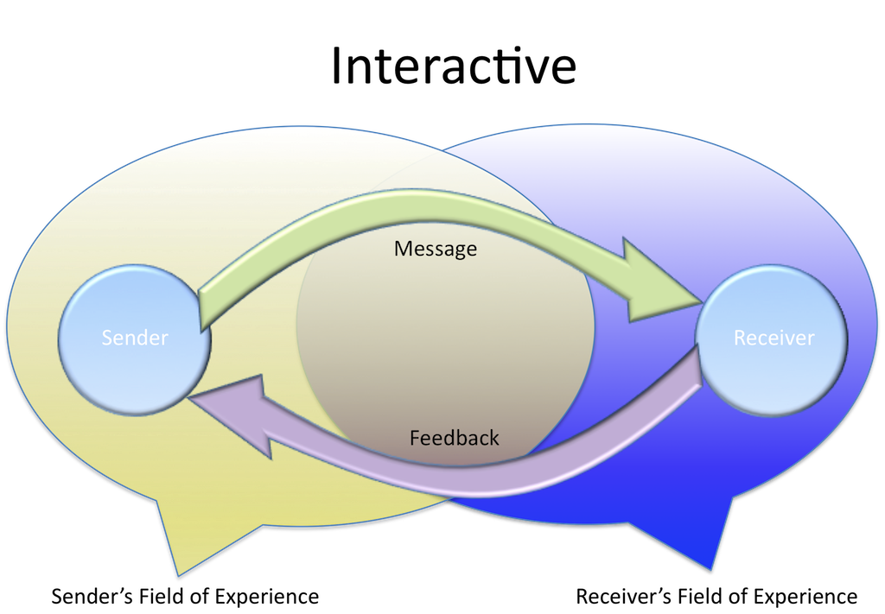
Interactional Model
A more dynamic view of communication (an ongoing process)
Wilbur Schramm (1954)- one of the earliest proponents of this model
Two channels in which communication and feedback flow between sender and receiver.
Both the sender and the receiver play active roles
Feedback can be verbal (i.e. “yes”) or nonverbal (i.e. a nod or smile).
Feedback indicates comprehension.
Examples: Email, Social media interactions

Slide 8
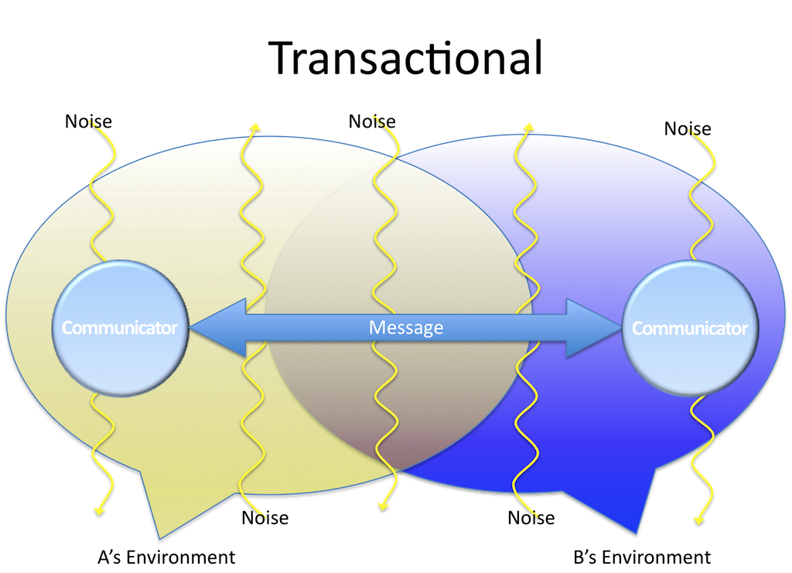
Transactional Model
Developed by Dean C. Barnlund in 1970
The most dynamic of communication models
Refers to people as senders and receivers to referring to people as communicators
Views communication as a transaction
People create shared meaning
Feedback comes fast
Examples: online discussion forums, video conferencing

Slide 9
Figurative Representation of Interactional Model
Ideation –
sender has an idea/ content – factual or emotional
Encoding – message is converted to words and gestures – select language, medium, form
Transmission – flow of message over the chosen channel – free from interference or noise
Decoding – converting message into thoughts- message is transferred, not meaning
Response – action or reaction of the speaker to the message - feedback

Slide 10
Process of Communication
Dynamic, interactive process
Effective transmission of facts, ideas, thoughts, feelings, values
Not passive – doesn’t just happen
Active and conscious process
Dynamic in nature – variety of forces and activities involved
Symbolic – use of symbols and gestures to communicate

Slide 11
Speech Act Theory
Speaker and receiver have to adhere to rules
Sender’s knowledge of the rules
Recipient’s conformity to the rules
Recipient’s conformity or deviation in a context
Relevance – creating utterances that ahere to the need and necessity of the situation
Coherence – logically and sequentially arranged utterances

Slide 12
The Cooperative Principle
Proposed by H.P. Grice
4 maxims
Maxim of quantity: neither too much nor too little
Maxim of quality: element of truth
Maxim of manner: brief, orderly, unambiguous
Maxim of relevance: statements relevant to the discussion

Slide 13
Types of Communication
Personal communication- conversations, email, text messages, online chats or direct messages, personal interviews, telephone conversations, live speeches, unrecorded course lectures, memos, letters, messages from non-archived discussion groups or online bulletin boards, social media shared with "Friends" only, etc.
Interpersonal communication- exchange of information, ideas, and emotions between two or more individuals. communication between a teacher and a student, two family members, two friends, and so on
Intrapersonal communication- the internal dialogue and communication that occurs within an individual. It can involve self-talk, acts of imagination and visualization, and even recall and memory. It helps us understand our own feelings, motivations, and perceptions.

Slide 14
Scope of Communication
Determining social behaviour
Transformation of society
Social Dimensions
knowledge
Access to information
Educational
Organizational
Management relations
Motivating employees, PR and publicity

Slide 15
Scope of Communication
Cultural and Entertainment
Promotion of cultural traditions
De-stressing
Connects people
Builds tolerance
Integrative

Slide 16
Quick check?
Communication is a one-way process.
Communication involves only words.
Meaning is crucial to communication.
Ideation is shaped by assumptions based on the sender’s experiences.
The sender often expects a response from the receiver.

Slide 17
Things to think about
How does communication help you at work and outside work?
What is the impact of using too much or too little information in one’s communication?
Find out names of 5 companies which have effective communication practices. Also note down the practices.

Slide 18
Thank You!

